Slide 1
DIGITAL PORTFOLIO
STUDENT NAME :ASWIN S
REGISTER NO :24BSAI114
NMID :B7F325AF17E14A5BCCA4D1963DE8BF1A
DEPARTMENT :B.SC ARTIFICIAL INTELLIGENCE AND MACHINE LEARNING
COLLEGE : SRI KRISHNA ADITHYA COLLEGE OF ARTS AND SCIENCE
UNIVERSITY BHARATHIYAR UNIVERSITY

Slide 2
ONLINE STUDENT FEEDBACK SYSTEM
PROJECT TITLE

Slide 3
INTRODUCTION
Feedback is essential to improve teaching quality and student learning.
Online Student Feedback System provides a digital platform for students to submit feedback.
Objective: Create a simple web-based feedback system using HTML, CSS, JavaScript

Slide 4
PROJECT OVERVIEW
Frontend: HTML + CSS + JavaScript
Focus: Collect and display student feedback
Output: Responsive feedback form with submission functionality

Slide 5
FEATURES
Easy-to-use feedback form
Collects name, email, rating, and comments
Displays submitted feedback dynamically
Responsive design for desktop and mobile

Slide 6
PROJECT CODE (HTML)
<!DOCTYPE html>
<html lang="en">
<head>
<meta charset="UTF-8">
<meta name="viewport" content="width=device-width, initial-scale=1.0">
<title>Student Feedback System</title>
<link rel="stylesheet" href="style.css">
</head>
<body>
<div class="container">
<h1>Online Student Feedback System</h1>
<form id="feedbackForm">
<input type="text" id="name" placeholder="Your Name" required>
<input type="email" id="email" placeholder="Your Email" required>
<select id="rating">
<option value="5">Excellent</option>
<option value="4">Good</option>
<option value="3">Average</option>
<option value="2">Poor</option>
<option value="1">Very Poor</option>
</select>
<textarea id="comments" placeholder="Your Comments" required></textarea>
<button type="submit">Submit Feedback</button>
</form>
<div id="feedbackList">
<h2>Submitted Feedback</h2>
<ul id="list"></ul>
</div>
</div>
<script src="script.js"></script>
</body>
</html>

Slide 7
PROJECT CODE (CSS)
body {
font-family: Arial, sans-serif;
background: #f4f4f4;
margin: 0;
padding: 0;
display: flex;
justify-content: center;
align-items: center;
min-height: 100vh;
}
.container {
background: #fff;
padding: 20px;
border-radius: 10px;
box-shadow: 0 0 10px rgba(0,0,0,0.1);
width: 400px;
}
input, select, textarea, button {
width: 100%;
padding: 10px;
margin: 10px 0;
border: 1px solid #ccc;
border-radius: 5px;
}
button {
background: #28a745;
color: #fff;
border: none;
cursor: pointer;
}
button:hover {
background: #218838;
}
#feedbackList {
margin-top: 20px;
}

Slide 8
PROJECT CODE (JAVA)
document.getElementById("feedbackForm").addEventListener("submit", function(e) {
e.preventDefault();
let name = document.getElementById("name").value;
let email = document.getElementById("email").value;
let rating = document.getElementById("rating").value;
let comments = document.getElementById("comments").value;
let feedbackItem = document.createElement("li");
feedbackItem.innerHTML = `<strong>${name}</strong> (${email}) - Rating: ${rating}/5 <br> ${comments}`;
document.getElementById("list").appendChild(feedbackItem);
document.getElementById("feedbackForm").reset();
});

Slide 9
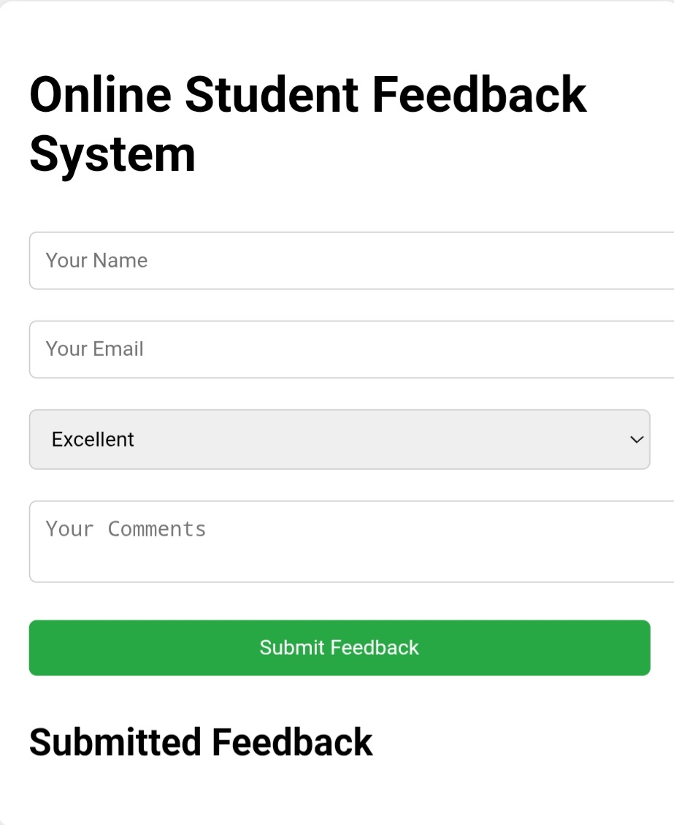
OUTPUT

Slide 10
CONCLUSION
Created an online feedback system using HTML, CSS, JavaScript.
Students can easily provide ratings and comments.
System can be enhanced with backend integration for data storage and analysis.

